Slide 1

AgrIoT
By:
K.Kirishikesan
01/05/2020

Slide 2
Introduction
A network of sensor nodes which collect data such as humidity, temperature, moisture gradient, light intensity and electrical conductivity and an airborne drone which collects image data and integrates the system for data analysis.
Parts of the project:
Sensor nodes
Mesh network of nodes
Communication protocol between node and drone
Drone
Data analysis
01/05/2020

Slide 3
Phase 1
Done by:
Aruna Jayasena
Radershan Suguneswaran
Ketharan Suntharam
Thiru Ashok
Created a prototype for Sensor Node with a custom sensor for Electrical conductivity
Created an app with cloud storage for data collection from a single node
Created drone based image data collection
01/05/2020

Slide 4
Phase 2
Done by:
A.L.D.S. Liyanage
K.Kirishikesan
A communication protocol between sensor nodes and the drone
Mesh network of nodes
01/05/2020

Slide 5
Power Consumption of protocol in phase 2
HC12- sleep………………….80µA
HC12- transmission……..3.6mA
Stm32f103c8t6…………….8mA
Total current consumption per hour:29.6928A
6 months:5344.704
Needed battery:494mAh battery
01/05/2020

Slide 6
Phase 3
By:
K.Kirishikesan
Production ready sensor nodes
Dynamic mesh network functionality
Communication protocol to communicate with the drone
01/05/2020

Slide 7
Work breakdown
Mesh network creation
Communication protocol
Implementation of protocol
Implementation of Sensor node
Enclosure design
Enclosure printing
Electrical conductivity sensor design
RFC
PCB design
PCB printing
Assembly and finish
01/05/2020

Slide 8
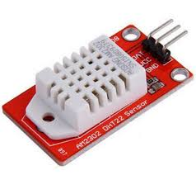
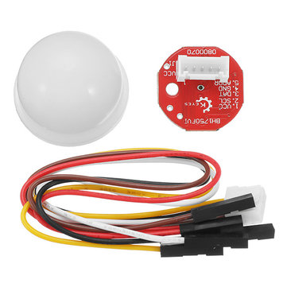
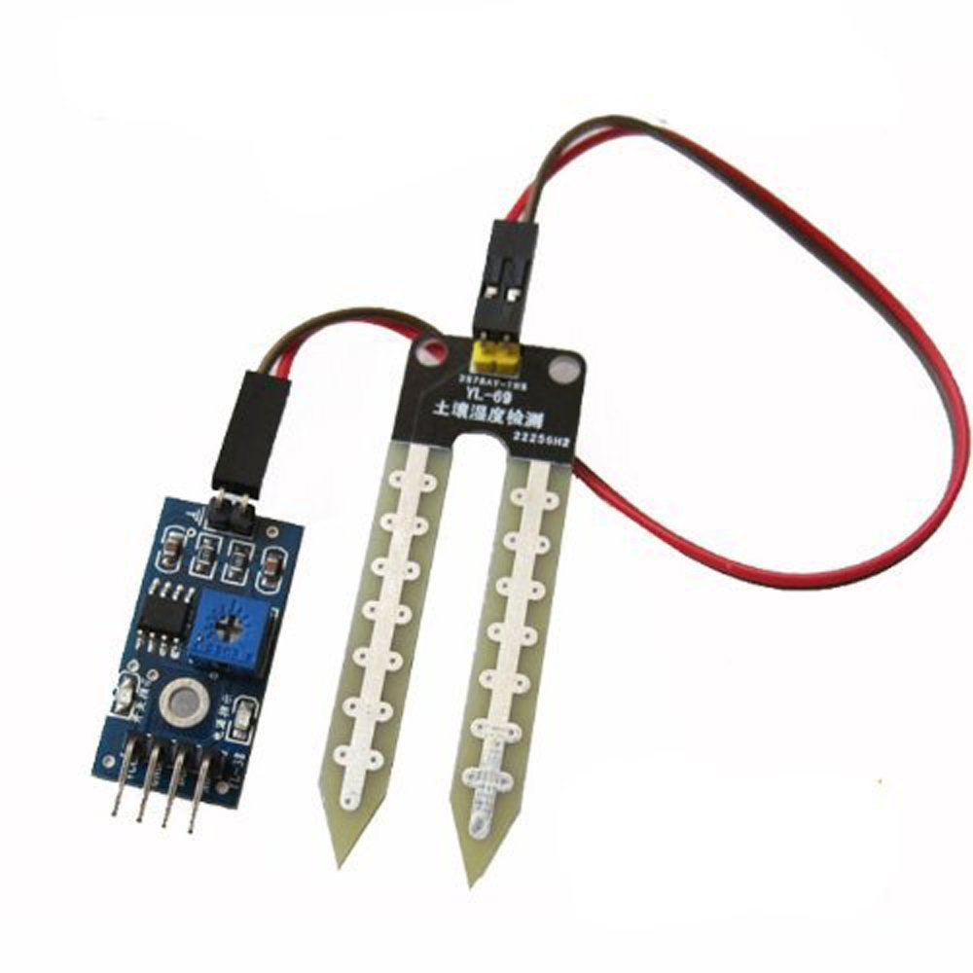
Sensor node
Sensor node is equipped with the following sensors
DHT22/AM2302 Temperature & Humidity sensor
BH1750 Light Intensity sensor
YL69 Soil moisture sensor
01/05/2020

Slide 9
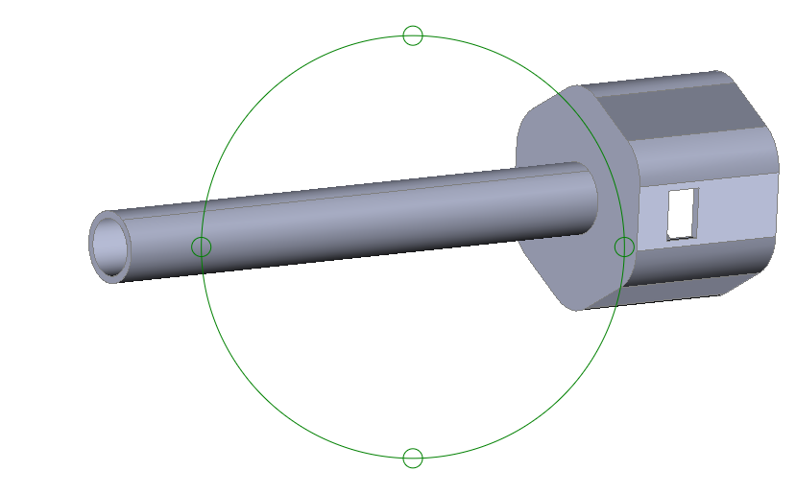
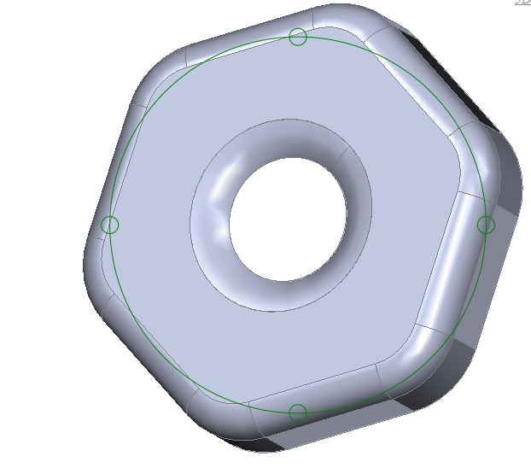
Enclosure
01/05/2020

Slide 10
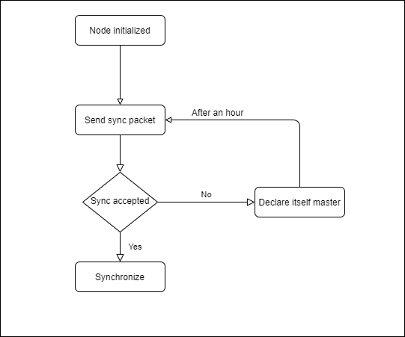
Mesh network creation
01/05/2020

Slide 11
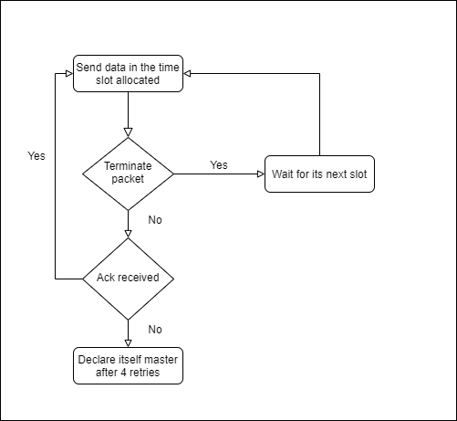
Send data as to master
01/05/2020

Slide 12
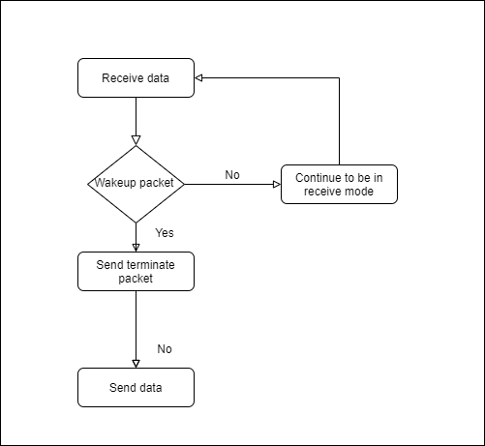
Receive data as master from other nodes
01/05/2020

Slide 13
Implementation issues and solutions
Multiple masters: Every master will keep a list of all the node ids that were synced with this master and will discard any message send from any other nodes and will not respond
Master role switch: As the master will be continuously keeping its radio on, the master role will be switched after every 4 hours. The slaves which are connected to the master will try to send data in their next round but will fail to receive acks and then declare themselves master. After an hour they will start synchronization again and eventually be part of the network
Hidden node problem: The node will declare itself a master
Too much traffic: Only the masters will transfer data to the drone
Power fluctuation if radio is on for more than 5 days: every 4 hours master role will be switched.
01/05/2020

Slide 14
Frame Structure when in sync state
1 bit to identify state
8 bit sender id
8 bit receiver id
Content:Timestamp
4bit Error bits(even parity in blocks)
01/05/2020

Slide 15
Frame Structure when in Data-transfer state
1 bit to identify state
3 bit code to identify type of frame
8 bit drone id
8 bit node id
Content: Data or initial or final sequence number of transmission
4bit Error bits(even parity in blocks)
01/05/2020

Slide 16
Frames and their identification codes
Wake-up frame(001)
Request frame(010)
Response frame(011)
Data frame(100)
Ack frame(101)
Retransmission frame(110)
Termination frame(111)
Switchrole frame(000)
01/05/2020

Slide 17
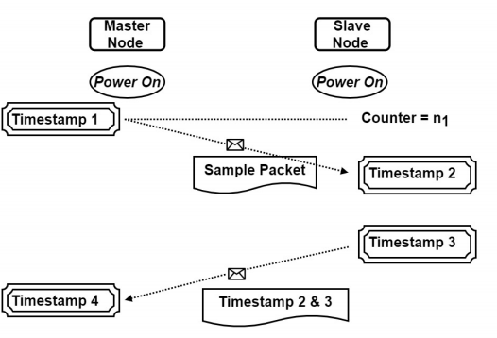
Message based Synchronization
Other
node
Master
node
Time of slave node will be reset to = t4+ ((t2-t1)+(t4-t3))/2
01/05/2020

Slide 18
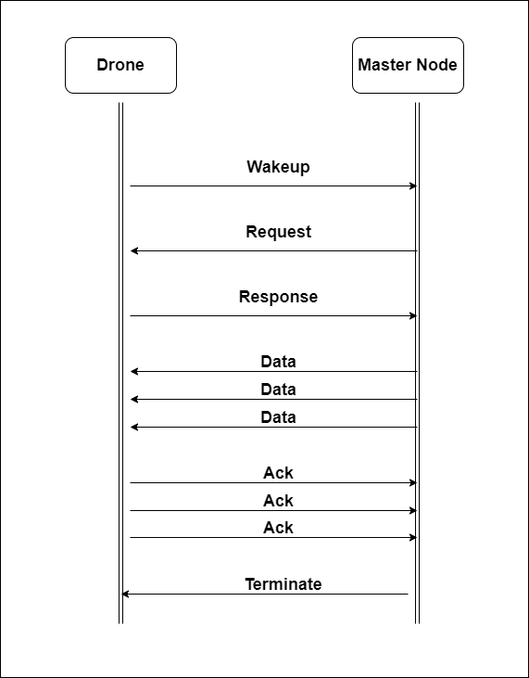
Communication protocol
01/05/2020

Slide 19
Progress
Mesh network creation …………………………. Complete
Communication protocol ………………………. Complete
Implementation of protocol…………………… Pending
Implementation of Sensor node…………….. Pending
Enclosure design……………………………………….Complete
Enclosure printing…………………………………….Pending
Electrical conductivity sensor design …….. Pending
RFC…………………………………………………………….Pending
PCB design……………………………………………....Pending
PCB printing………………………………………………Pending
Assembly and finish………………………………….Pending
01/05/2020

Slide 20
Next week progress
PCB design
Electrical conductivity sensor integration
01/05/2020

Slide 21
Week 9 continued…
Redesigned objectives:
Design Mesh network………………………………………………………………………Complete
Design Communication protocol between node and drone…………..Complete
Simulate Mesh network…………………………………………………………………..On Progress
Simulate Communication protocol………………………………………………….On Progress
Combine Simulations……………………………………………………………………….Incomplete
Include power consumption calculation with the simulation…………Incomplete
Prepare an RFC…………………………………………………………………………………Incomplete
08/05/2020

Slide 22
Redefined Deliverables
Working Simulations of mesh network and communication protocol
Complete RFC
08/05/2020

Slide 23
This week’s progress
Familiarized myself with Omnet++ Discrete Event Simulator Framework
Unique id solution for the mesh network design.(Using mac-id)
Completed two simple simulations.
Drone to master node communication (One drone and one master)
Drone to master communication (One drone and 4 masters)
08/05/2020

Slide 24
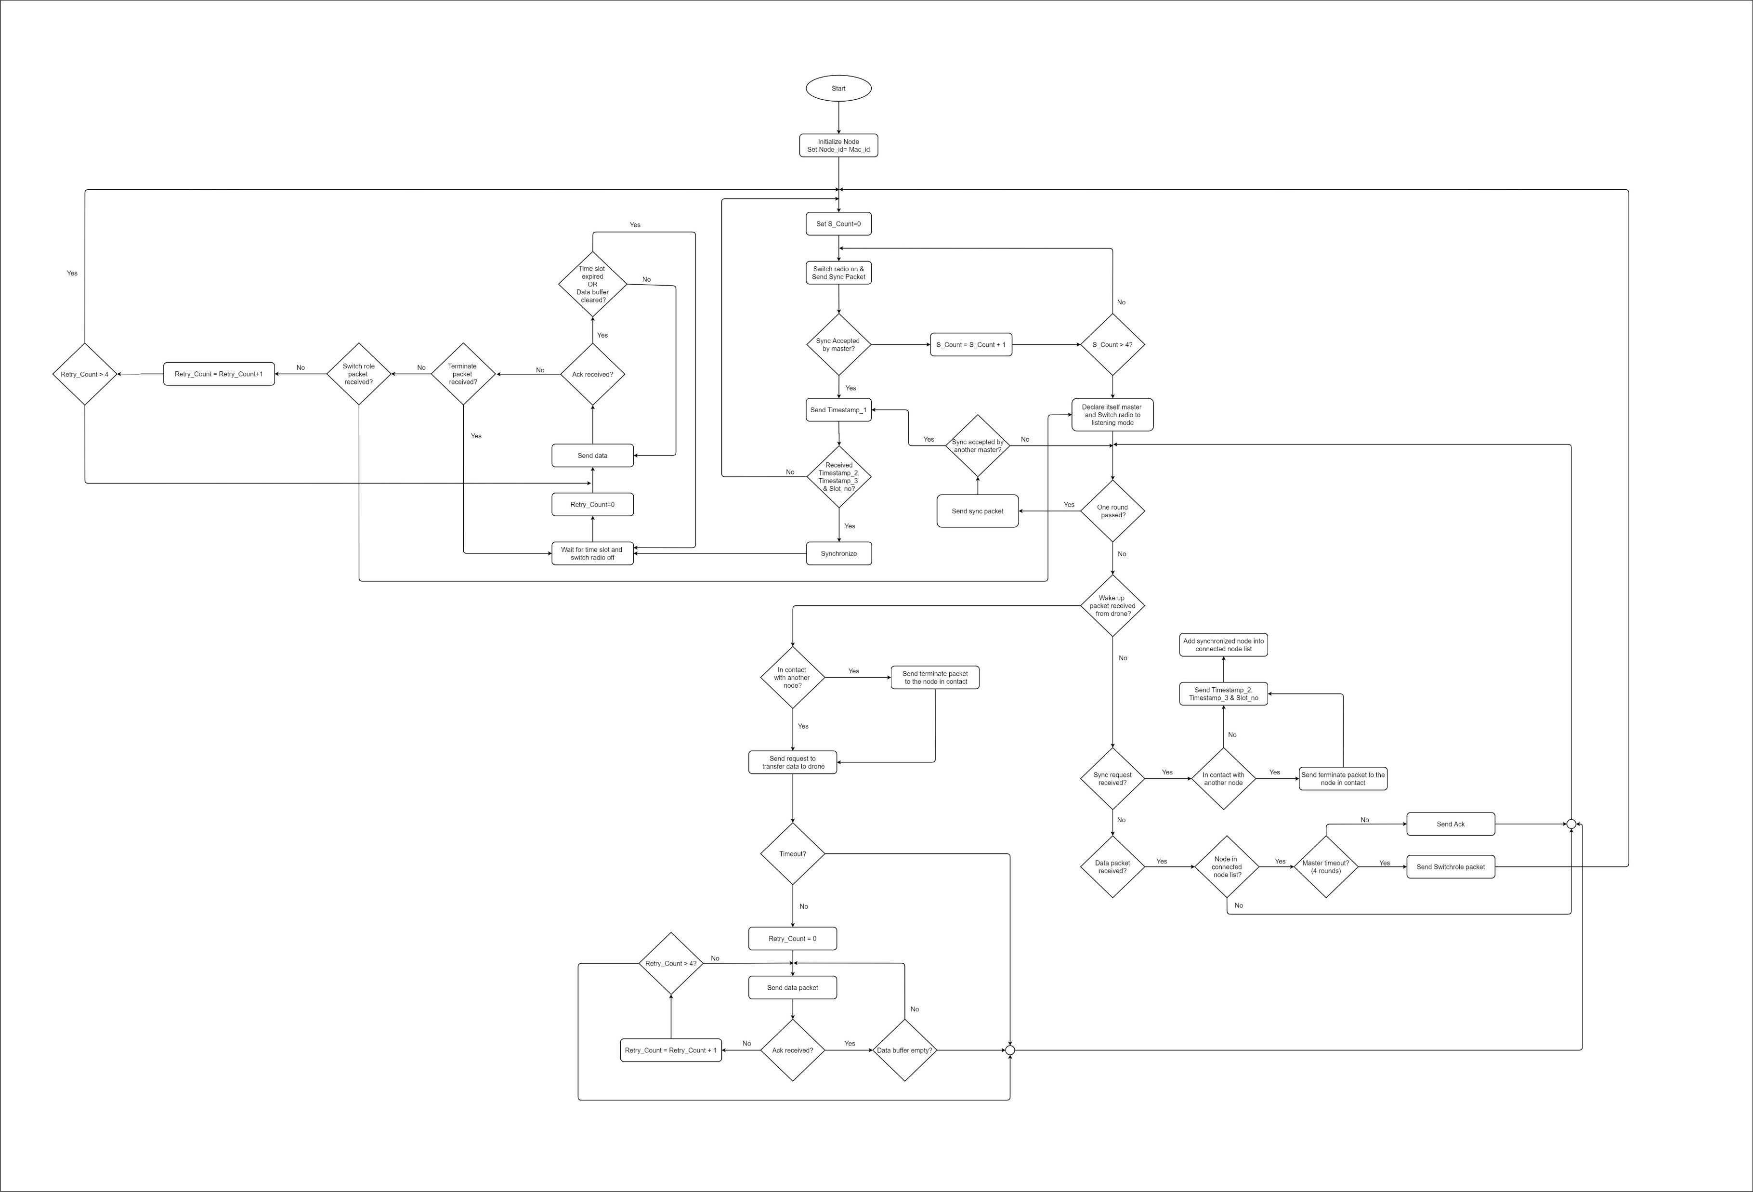
Lifecycle of the node
08/05/2020

Slide 25
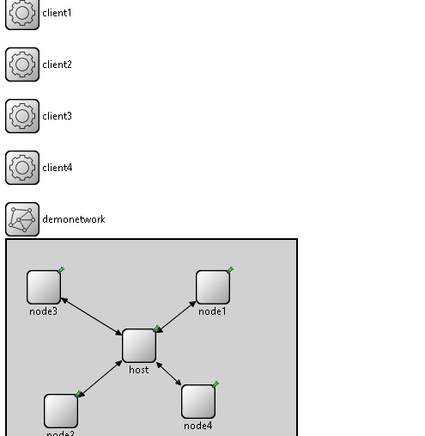
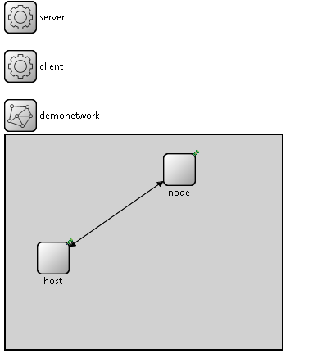
Simulations
08/05/2020

Slide 26
Next week goals
Complete the simulation taking into account,
Jitter
Propagation delay
Signal strength and distance
Time to switch on radio
Build a submodule to calculate power consumption
08/05/2020

Slide 27
Week 10
Objectives:
Design Mesh network………………………………………………………………………Complete
Design Communication protocol between node and drone…………..Complete
Simulate Mesh network…………………………………………………………………..On Progress
Simulate Communication protocol………………………………………………….On Progress
Combine Simulations……………………………………………………………………….Incomplete
Include power consumption calculation with the simulation…………Incomplete
Prepare an RFC…………………………………………………………………………………Incomplete
15/05/2020

Slide 28
This week’s progress
Explored INET framework
Analyzed 3 simulations
Client Server based TCP communication between n nodes
Ethernet bus communication communication between n nodes
WLAN communication 2.4GHz and 5GHz.
Proposed a design structure for the sensor node and the drone
15/05/2020

Slide 29
Why INET?
Message passing communication between modules
Layered communication(OSI model)
Radio Medium can be modelled
Has inbuilt components for integration
15/05/2020

Slide 30
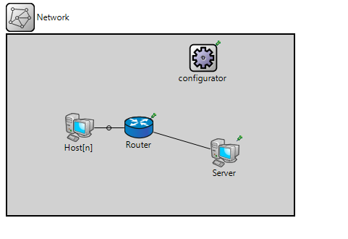
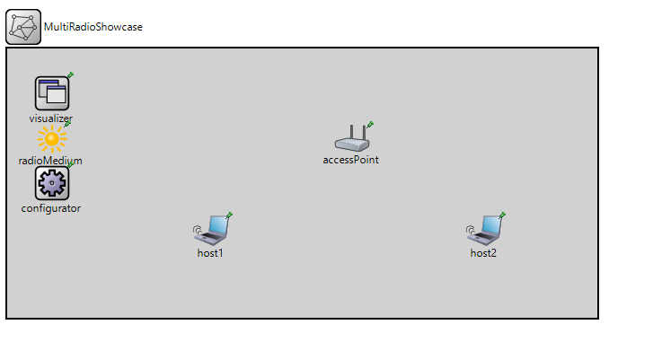
Simulations
15/05/2020

Slide 31
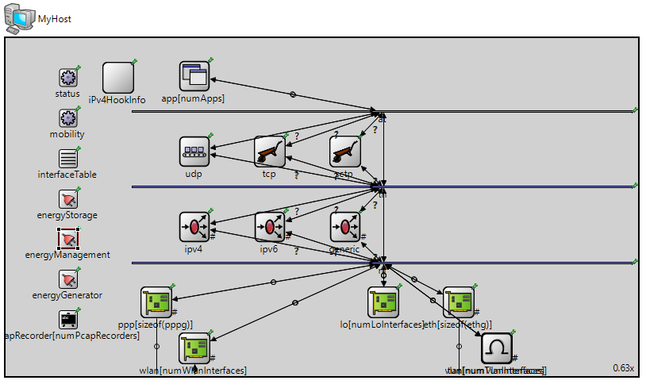
Design structure of a Wired Computer
15/05/2020

Slide 32
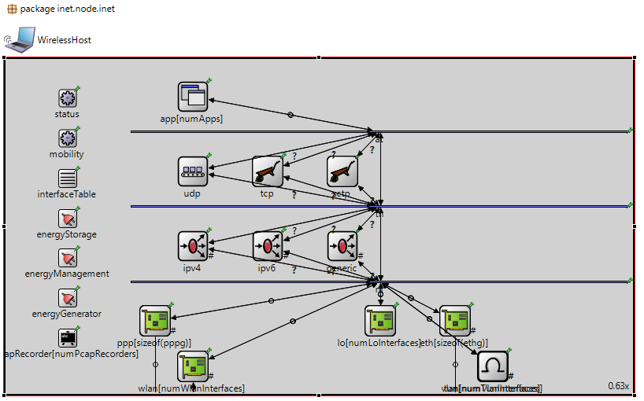
Design structure of a Wireless Computer
15/05/2020

Slide 33
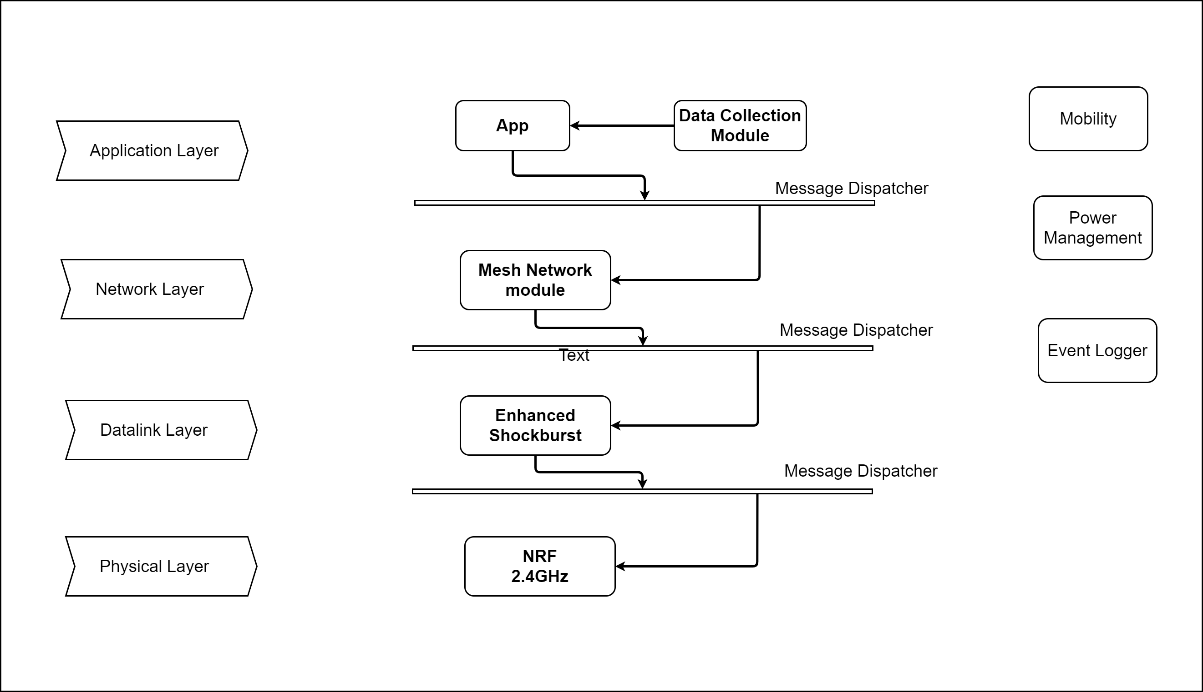
Proposed Structure of the Node
15/05/2020

Slide 34
Next Week Goals
Build Two Nodes with the proposed Structure (Without Enhanced Shockburst)
Pass Structured Messages
15/05/2020

Slide 35
Thank you!

